Slide 1
Applied Data Science Capstone Project
By
Blessing Nnenna Azubuike
IBM Data Science Professional Course

Slide 2
Executive Summary:
We used the SpaceX dataset to perform data collection, wrangling, and exploratory data analysis (EDA).
Interactive visualizations were created using Plotly and Folium to display launch data.
A predictive analysis was conducted with classification models (Logistic Regression, SVM, Decision Trees, KNN), and GridSearchCV was used to optimize model parameters.
We developed an interactive dashboard with Plotly Dash to present key findings and built an interactive map for geographic data visualization. Each model's accuracy was evaluated to determine the best-performing one.

Slide 3
Introduction
Project Overview: In this capstone, we aim to predict whether the Falcon 9 first stage will land successfully. SpaceX offers launches at a competitive cost of 62 million dollars, much lower than other providers due to their reusable first stage. Predicting the success of the first stage landing helps estimate launch costs, crucial for competitors bidding against SpaceX.
Learning Objectives:
Manipulate data in Python using Pandas
Convert JSON files into Pandas DataFrames
Create and share Jupyter notebooks via GitHub
Apply data science methods to define and solve business problems
Analyze and gain insights from real-world datasets

Slide 4
EDA and Interactive Visual Analytics Methodology
Methodology Overview: We collected data on Falcon 9 first-stage landings using a RESTful API and web scraping. The raw data was converted into a Pandas DataFrame, followed by data wrangling to clean and organize it for analysis.
Objectives:
Collected and transformed data into a structured format for analysis
Conducted exploratory data analysis (EDA) to understand the dataset and uncover key insights
Performed Webscraping to pull out data from the web for analysis using beautiful soup.
Developed scatter plots and bar charts using Python to visualize trends and patterns
Executed SQL queries to select, filter, and sort relevant data
Utilized interactive visual analytics techniques, such as Plotly and Folium, to enhance understanding and guide predictive modeling decisions

Slide 5
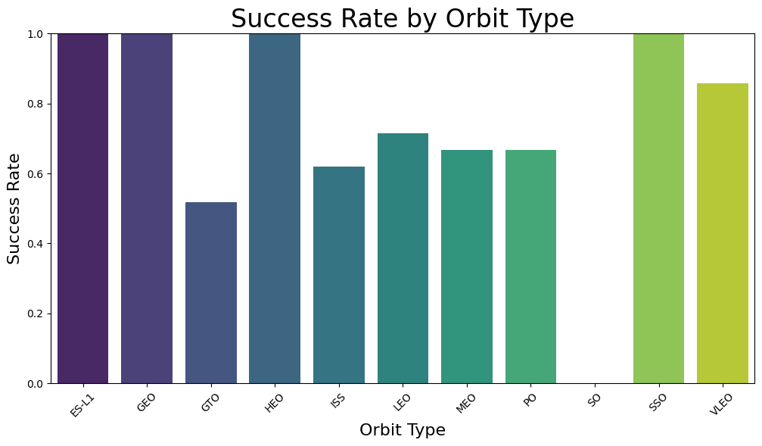
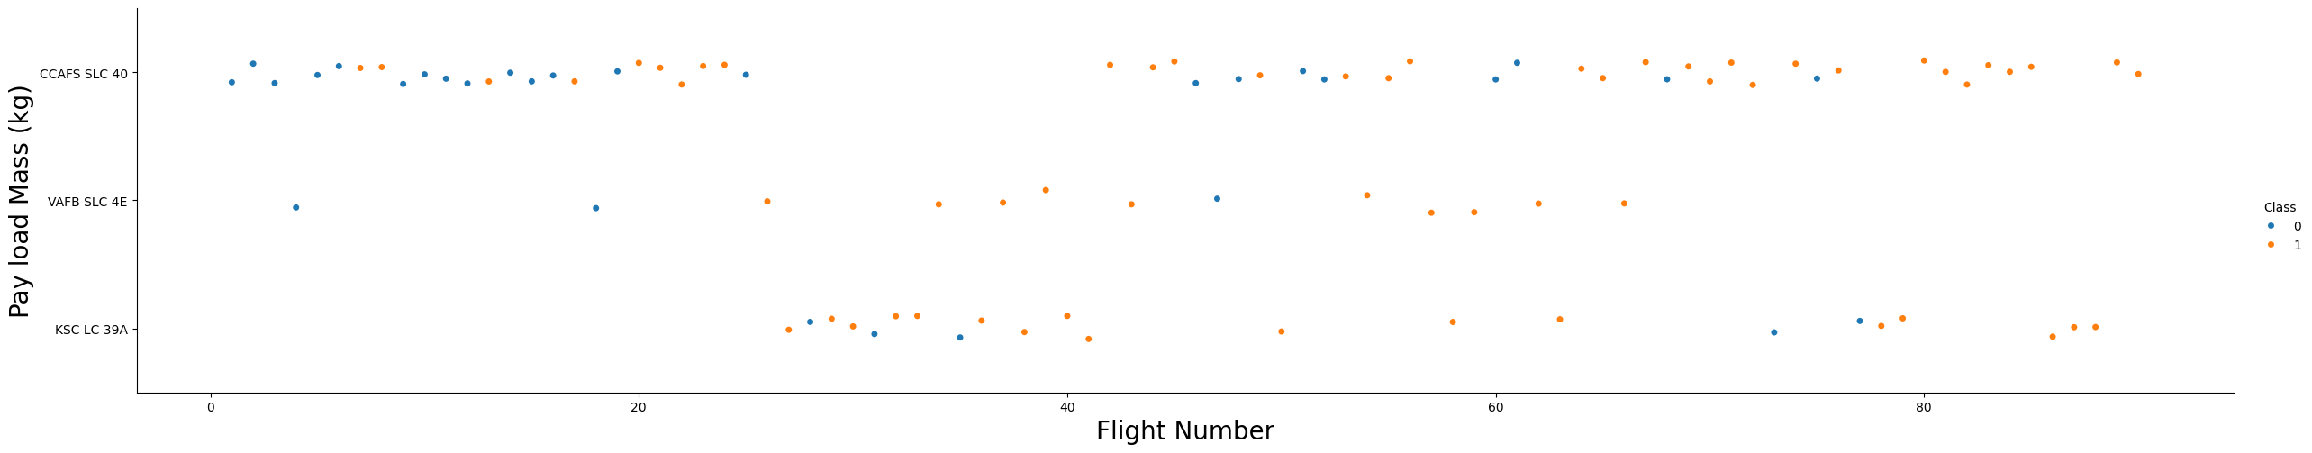
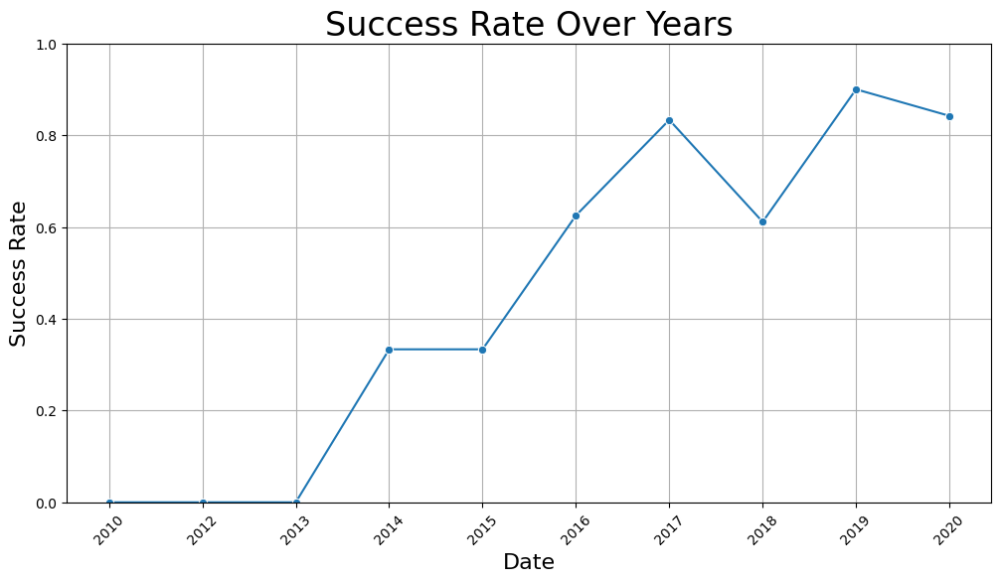
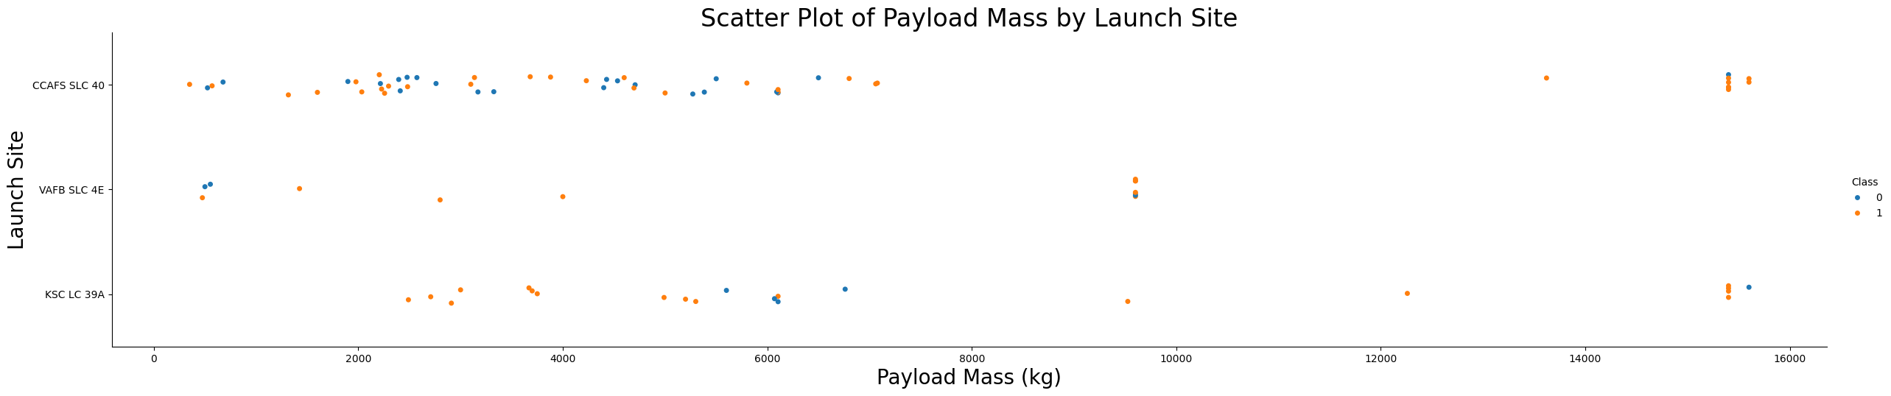
Results
TASK 1: Visualize the relationship between Flight Number and Launch Site
TASK 2: Visualize the relationship between Payload Mass and Launch Site
It can be inferred that Success Rate of missions increased as the Year went by.

Slide 6
From the EDA, We found out that the most common launch sites were CCAFS LC-40, VAFB SLC-4E, KSL LC-39A and CCAFS SLC -40
The average Payload mass carried was 2928.4 The First Successful Ground Pad Landing was in 2015
Four boosters which were successful had payload mass greater than 4000 but less than 6000
There were 100 total successful Outcomes and 1 failed outcome
Also from the map graphs, launch sites were in close proximity with highways and railways.

Slide 7
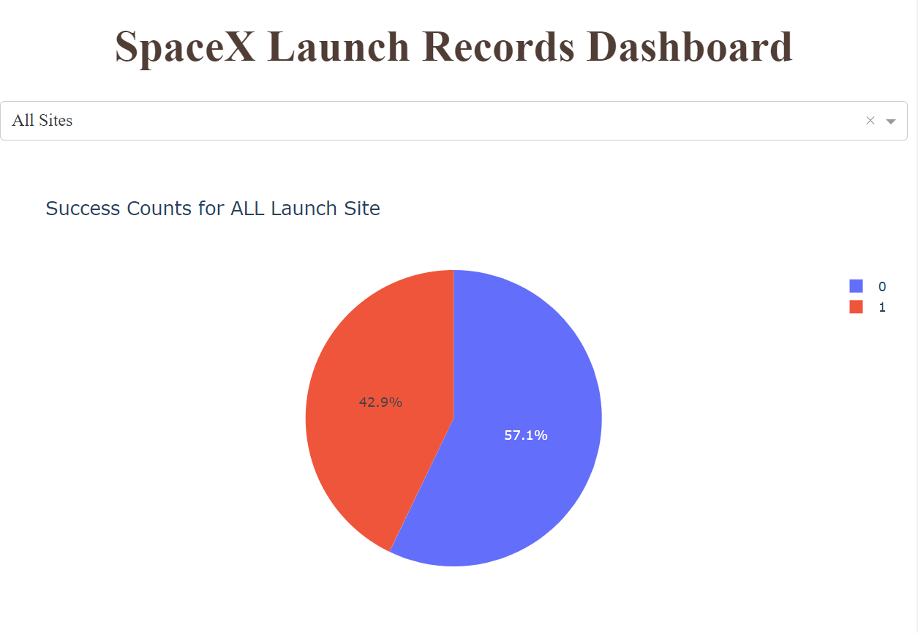
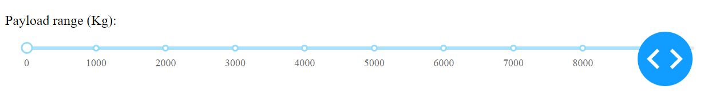
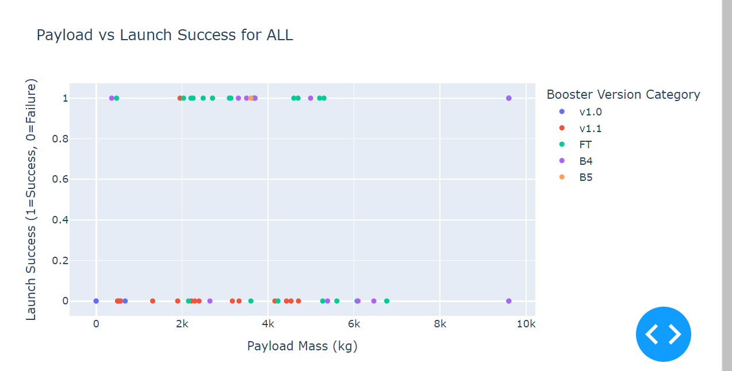
Dashboard Results

Slide 8
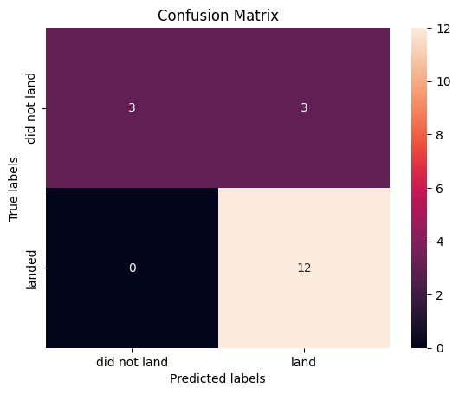
Linear Regression – Accuracy is 0.84

Slide 9
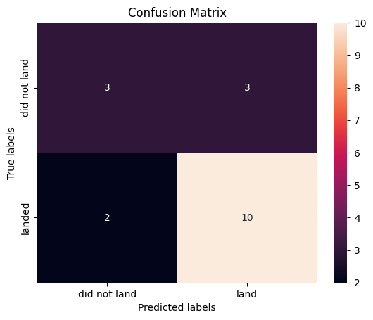
Support Vector Machines – 0.833
Decision Tree – 0.73

Slide 10
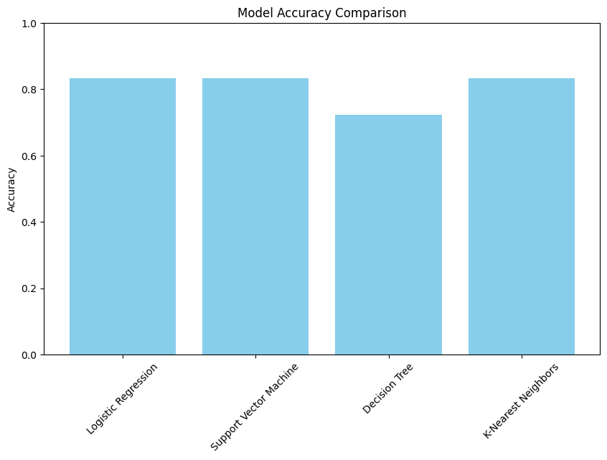
KNN Neighbours = 0.833
Best Performing Model:
Model Logistic Regression
Accuracy 0.833333

Slide 11
Conclusion
In this capstone project, we successfully predicted the likelihood of the Falcon 9 first stage landing successfully, which is crucial for estimating the cost-efficiency of SpaceX launches. By applying data science methodologies, we:
Collected and wrangled real-world data from APIs and web scraping
Conducted extensive exploratory data analysis (EDA) to extract meaningful insights
Developed interactive visualizations to aid decision-making
Built and optimized machine learning models for classification, achieving reliable predictions on landing success
This analysis provides valuable insights for stakeholders, helping them assess the competitive advantage of reusable rockets in the space launch industry.

